Slide 1

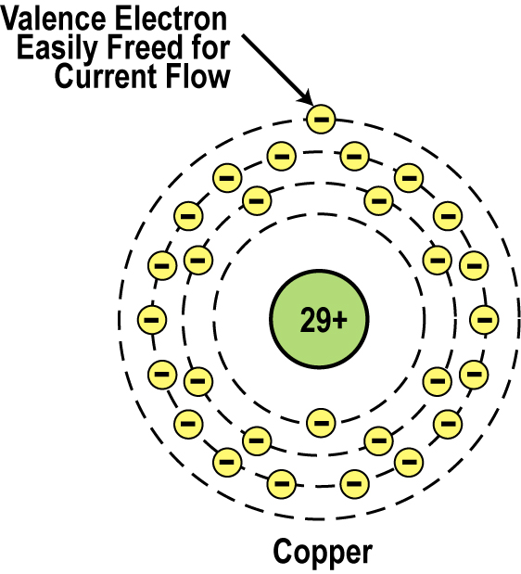
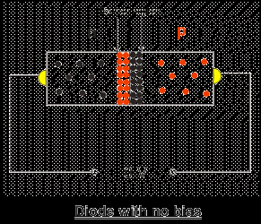
Introduction to Semiconductor Materials
_{Copper Atom}

Slide 2
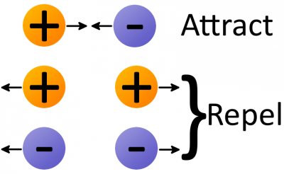
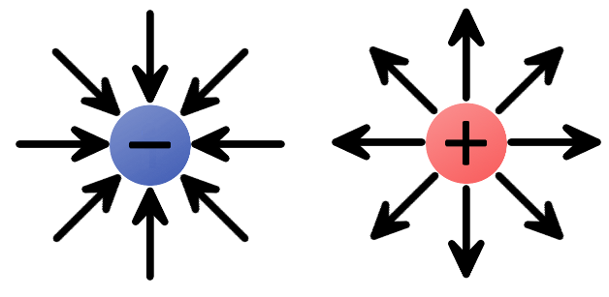
Electrostatic force
Electrostatic force (also called Coulomb’s law) is a force that operates between charges. It states that charges of the same type repel each other, while charges of opposite types are attracted together. Opposites attract, and likes repel.
A negative charge has an inward electric field because it attracts positive charges.
The positive charge has an outward electric field, pushing away like charges.

Slide 3
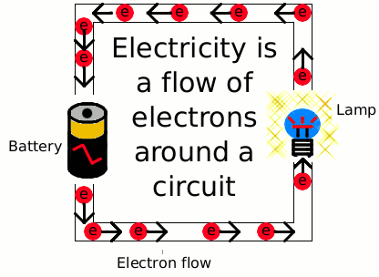
Electronic Materials
The goal is to generate and control the flow of an electrical current.
Electronic materials include:
Conductors: have low resistance which allows electrical current flow
Insulators: have high resistance which suppresses electrical current flow
Semiconductors: can allow or suppress electrical current flow

Slide 4
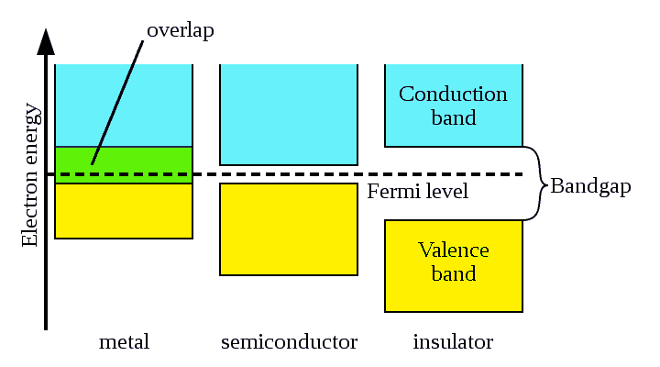
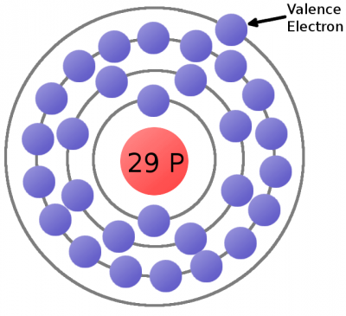
Conductors
This is a copper atom diagram: 29 protons in the nucleus, surrounded by bands of circling electrons. Electrons closer to the nucleus are hard to remove while the valence (outer ring) electron requires relatively little energy to be ejected from the atom.
outer ring
energy level

Slide 5
Conductors
Good conductors have low resistance. Electrons flow through them with ease.
The atomic structure of good conductors usually includes only one electron in their outer shell. It is called a valence electron.
It is easily striped from the atom, producing current flow.
Electric field
Copper Atom

Slide 6
Electron Flow in a Simple Circuit
Now consider a copper wire: if a free electron is floating in a space between atoms, it’s pulled by surrounding charges in that space.
This free electron eventually finds a new atom to latch on to; in doing so, the negative charge of that electron ejects another valence electron from the atom.
This chain effect can continue on and on to create a flow of electrons called electric current.
Electric field

Slide 7
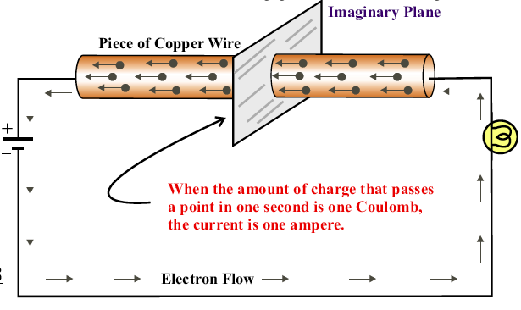
Electric Current

Slide 8
Insulators
Insulators have a high resistance so current does not flow in them. The atoms are tightly bound to one another so electrons are difficult to strip away for current flow.
Insulators have 8 valence electrons.
Good insulators include: Glass, ceramic, plastics, & wood.
Conduction band energy level
outer ring
energy level

Slide 9
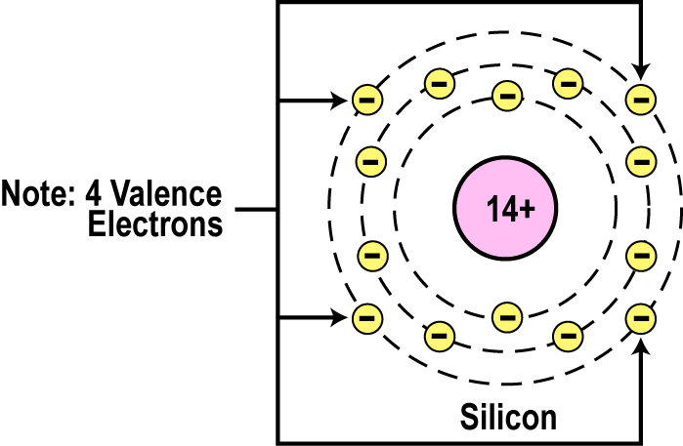
Semiconductors
Semiconductors are materials that essentially can be conditioned to act as good conductors, or good insulators, or any thing in between.
The main characteristic of a semiconductor element is that it has 4 valence electrons in its outer or valence orbit.
Common semiconductors elements such as carbon, silicon, and germanium. Silicon is the best and most widely used semiconductor.

Slide 10
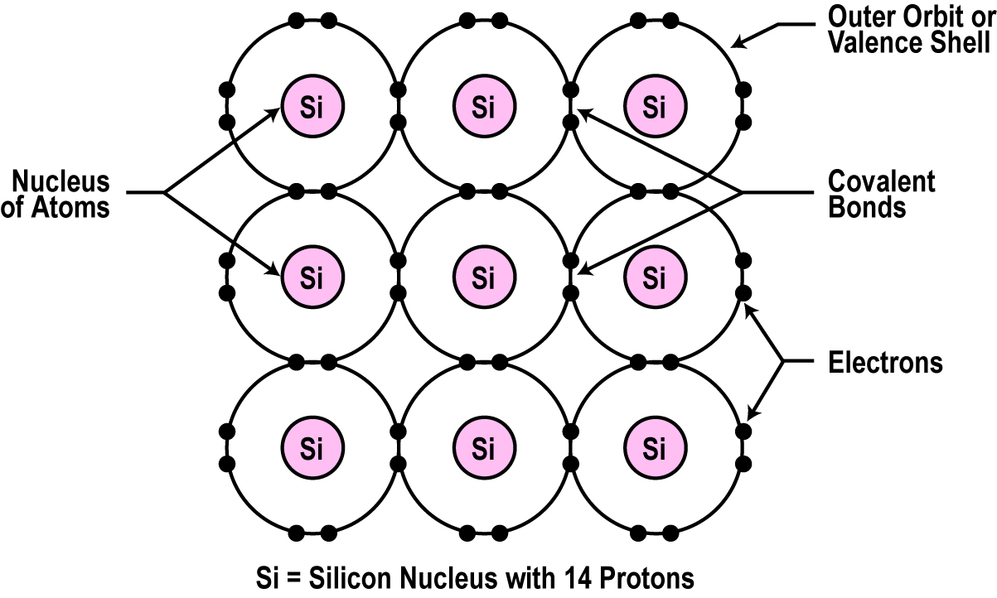
Crystal Lattice Structure
The unique capability of semiconductor atoms is their ability to link together to form a physical structure called a crystal lattice.
The atoms link together with one another sharing their outer electrons.
These links are called covalent bonds.
2D Crystal Lattice Structure

Slide 11
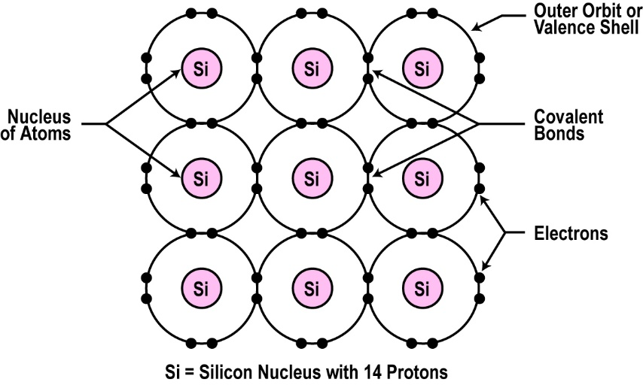
Semiconductors can be Insulators
If the material is pure semiconductor material like silicon, the crystal lattice structure forms an excellent insulator since all the atoms are bound to one another.
Silicon in this form is a great insulator.

Slide 12
Doping
To make the semiconductor conduct electricity, other atoms called impurities must be added.
donor atom
acceptor atom
hole
SI
N
P
SI
SI
SI
SI
N
SI
SI
SI
SI
SI
SI
SI
SI
SI
P
SI
SI
SI
SI
SI
SI
SI
SI
SI
SI
SI
SI
SI
SI
Covalent Bonding
Undoped Material Shares its 4 electrons w/other atoms and forms a pure crystal.
N type Material
Impurities that have an excess of electrons are added.
- charged
P type Material.
Impurities that have missing electron are added.
+ charged.

Slide 13
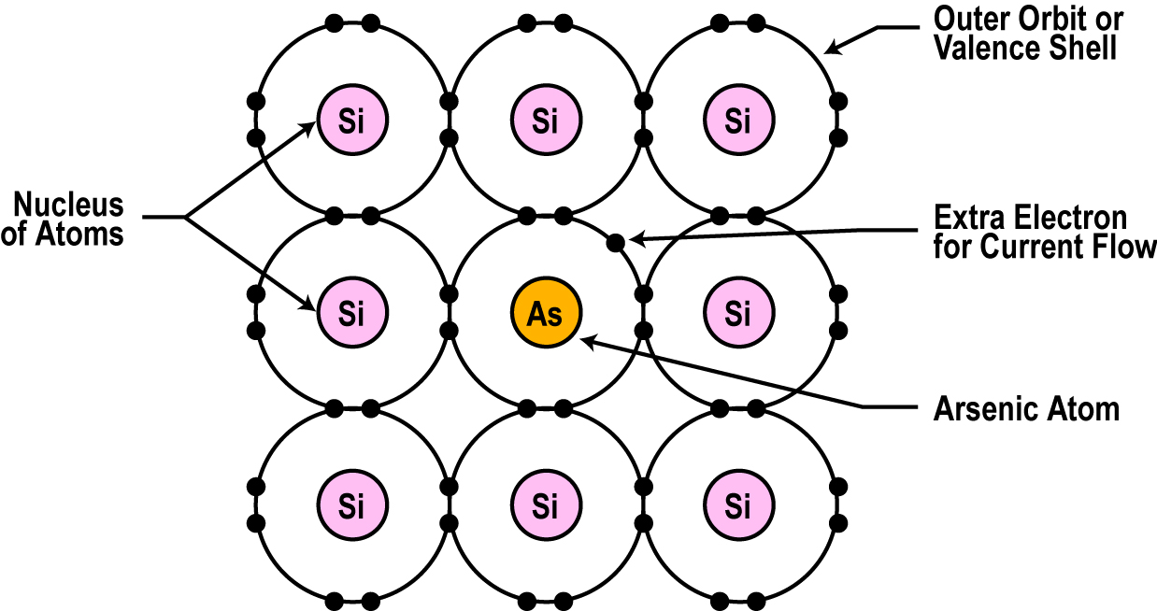
Semiconductors can be Conductors
An impurity, or element like arsenic, has 5 valence electrons.
Adding arsenic (doping) will allow four of the arsenic valence electrons to bond with the neighboring silicon atoms.
The one electron left over for each arsenic atom becomes available to conduct current flow.
n-type material

Slide 14
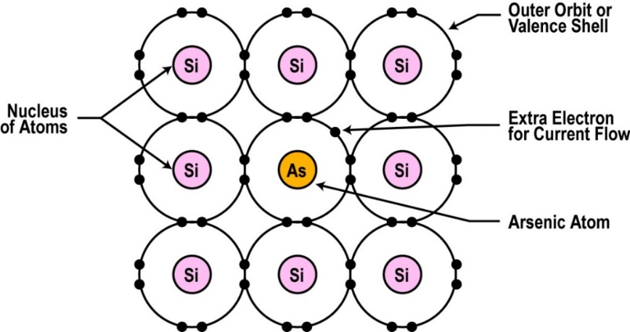
n-type material
If you use lots of arsenic atoms for doping, there will be lots of extra electrons so the resistance of the material will be low and current will flow freely.
If you use only a few arsenic atoms, there will be fewer free electrons so the resistance will be high and less current will flow.
By controlling the doping amount, virtually any resistance can be achieved.
Majority Charge Carriers are Electrons.
N
N
N
SI
SI
SI
SI
SI
SI
SI
SI
SI
SI
SI
SI
SI
N
N
SI
SI
SI
SI
SI

Slide 15
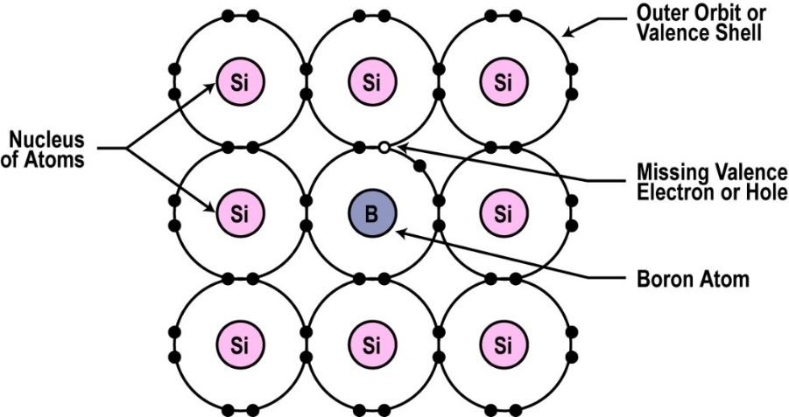
p-type material
You can also dope a semiconductor material with an atom such as boron that has only 3 valence electrons.
The 3 electrons in the outer orbit do form covalent bonds with its neighboring semiconductor atoms as before. But one electron is missing from the bond. This place, where a fourth electron should be is referred to as a hole.
The hole is assumed as a positive charge so it can attract electrons from some other source.
Holes become a type of current carrier like the electron to support current flow.
Majority Carriers are Holes.
SI
SI
SI
SI
SI
SI
P
P
SI
SI
SI
SI
SI
SI
P
P
SI
SI
SI
SI
SI
SI

Slide 16
p-type material
The positive terminal of the voltage source pulls the electrons from the holes and leaving the holes to attract more electrons.
Current (electrons) flows from the negative terminal to the positive terminal of the voltage source.
Inside the semiconductor, current flow is actually by the movement of the holes from positive to negative.
I
P
P
P
V

Slide 17
Carrier Concentration
Intrinsic Semiconductors (Pure single-crystal material)
For an intrinsic semiconductor, the concentration of electrons (n_{i}) in the conduction band is equal to the concentration of holes (p_{i}) in the valence band.
n_{i} : intrinsic electron concentration
p_{i} : intrinsic hole concentration
SI
n_{i} = p_{i}
ni :intrinsic carrier concentration, which refers to either the intrinsic electron or hole concentration
SI
SI
SI
SI
SI
SI
SI
SI
SI

Slide 18
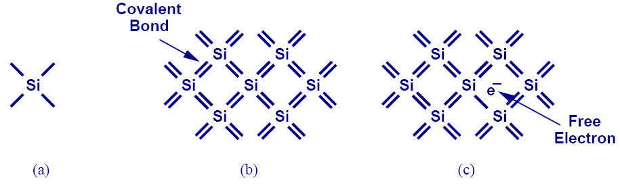
Silicon
Si has four valence electrons. Therefore, it can form covalent bonds with four of its neighbors.
When temperature goes up, electrons in the covalent bond can become free.

Slide 19
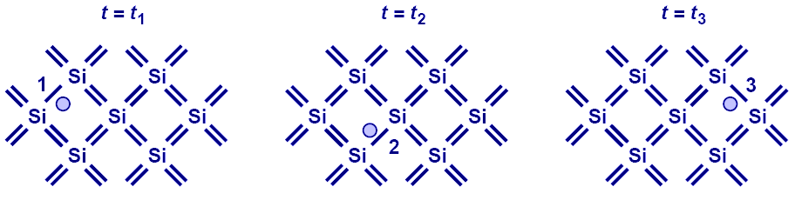
Electron-Hole Pair Interaction
With free electrons breaking off covalent bonds, holes are generated.
Holes can be filled by absorbing other free electrons, so effectively there is a flow of charge carriers.

Slide 20
Electron and Hole Concentrations in n and p type materials
Under thermal equilibrium conditions, the product of the conduction-electron density and the hole density is ALWAYS equal to the square of n_{i}
n_{i} : The concentration of conduction electrons in intrinsic silicon
N-type material
P-type material
Number acceptor atoms
Number of free electrons in n-type
Number donor atoms

Slide 21
Electron and Hole Densities
Majority Carriers (p type) :
Minority Carriers (p type) :
Majority Carriers (n type) :
Minority Carriers (n type) :
The product of electron and hole densities is ALWAYS equal to the square of intrinsic electron density regardless of doping levels.

Slide 22
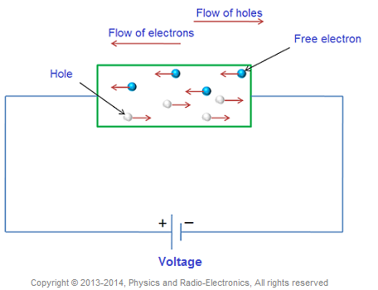
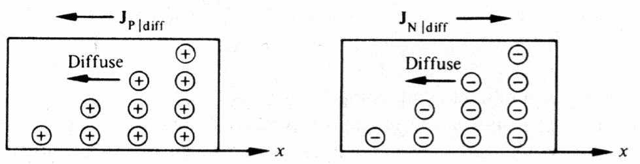
Current Flow in Semiconductors
There are two mechanisms by which holes and electrons move through a crystal:
Drift Current
Diffusion Current

Slide 23
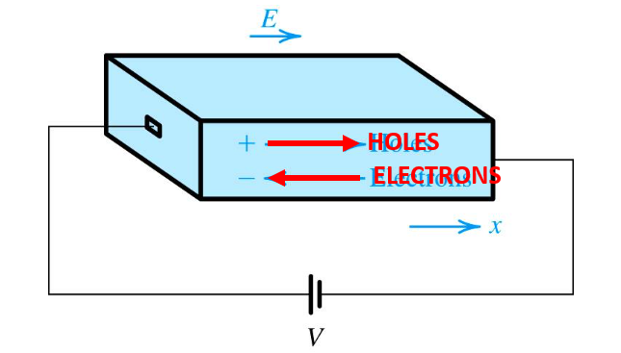
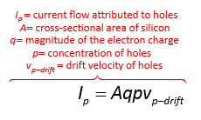

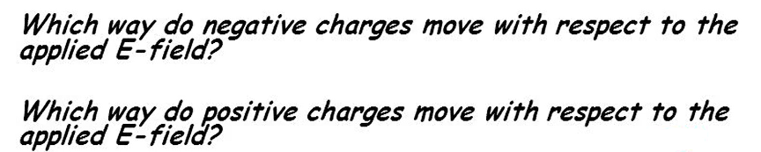
Drift Current
Drift current is caused by electric fields.
Direction of the drift current is always in the direction of the electric field.

Slide 24
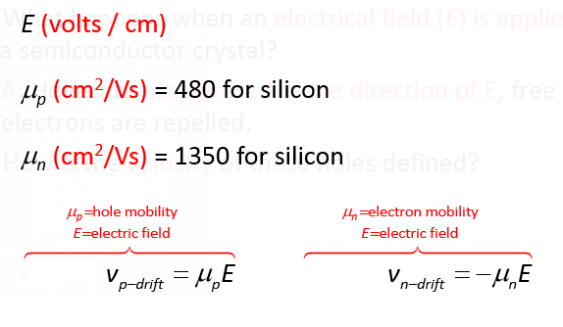
Drift current
Electrons move with velocity 2.5 times higher than holes
Drift velocity
What is mobility µ?
In solid-state physics, the electron mobility (hole) characterizes how quickly an electron (hole) can move through a metal or semiconductor, when pulled by an electric field.

Slide 25
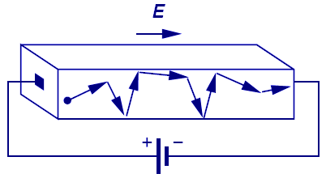
First Charge Transportation Mechanism: Drift
The process in which charge particles move because of an electric field is called drift.
Charge particles will move at a velocity that is proportional to the electric field.

Slide 26
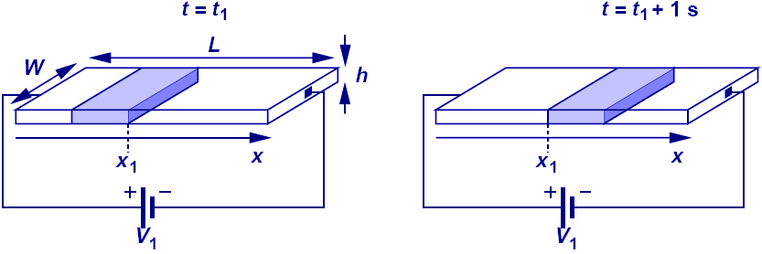
Current Flow: General Case
Electric current is calculated as the amount of charge in v meters that passes thru a cross-section if the charge travel with a velocity of v m/s.

Slide 27
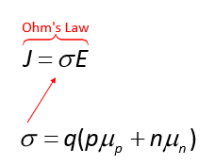
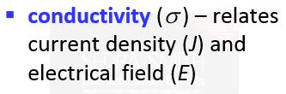
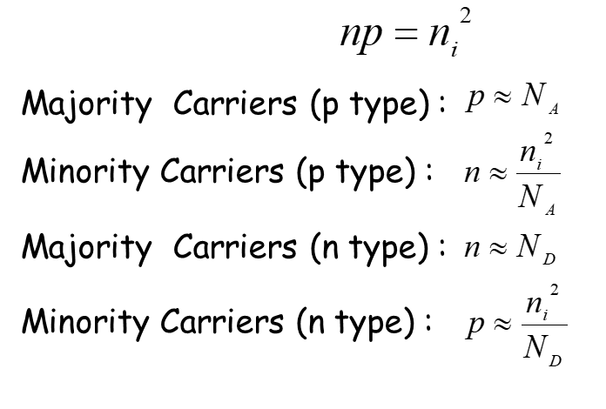
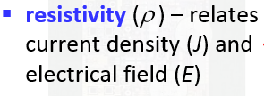
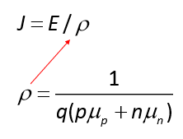
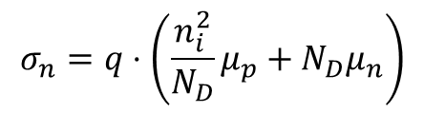
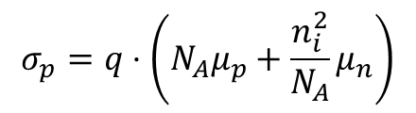
Current Flow: Drift
Since velocity is equal to μE, drift characteristic is obtained by substituting velocity (ν) with μE in the general current equation.
The total current density consists of both electrons and holes.
Conductivity of P type material
Conductivity of N type material
$$σ_{p}=q⋅\left(N_{A}μ_{p}+\frac{n_{i}^{2}}{N_{A}}μ_{n}\right)$$
$$σ_{n}=q⋅\left(\frac{n_{i}^{2}}{N_{D}}μ_{p}+N_{D}μ_{n}\right)$$

Slide 28
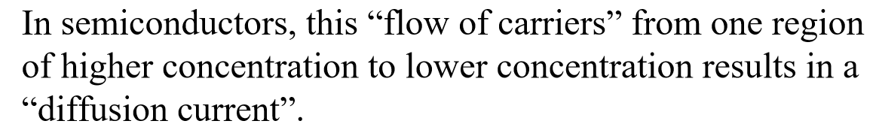
Diffusion Current

Slide 29
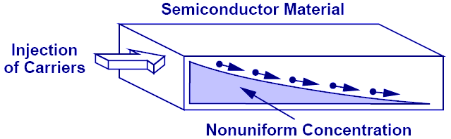
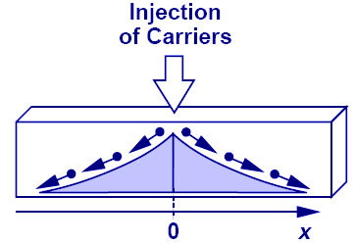
Second Charge Transportation Mechanism: Diffusion
Charge particles move from a region of high concentration to a region of low concentration. It is analogous to an every day example of an ink droplet in water.

Slide 30
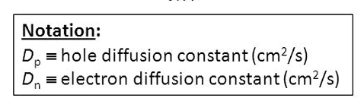
Current Flow: Diffusion
Diffusion current is proportional to the gradient of charge (dn/dx) along the direction of current flow.
Its total current density consists of both electrons and holes.

Slide 31
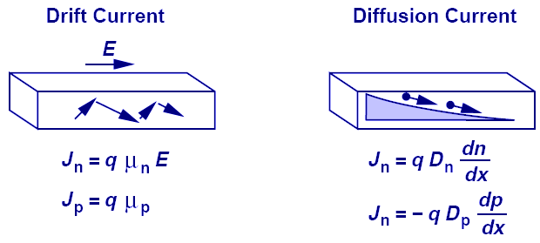
Einstein's Relation
Boltzman constant
Temperature
Magnitude of electron charge
While the underlying physics behind drift and diffusion currents are totally different, Einstein’s relation provides a mysterious link between the two.

Slide 32
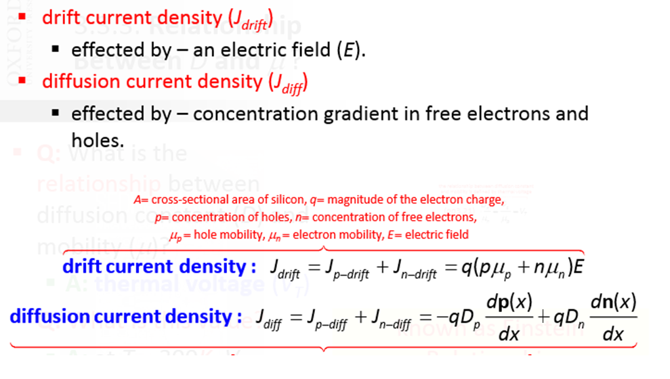
Total Current

